Slide 1
Department of Applied Mathematics and Computational Sciences
III Sem M.Sc.Software Systems
Transform Techniques
Dr. V. Suresh kumar

Slide 2
Simple problems

Slide 3
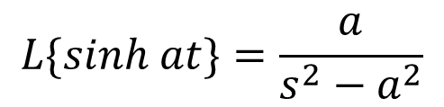
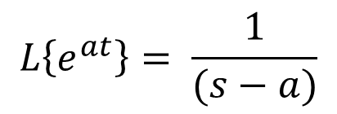
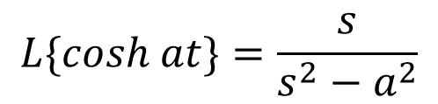
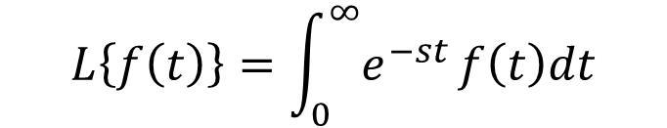
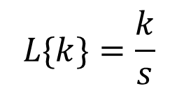
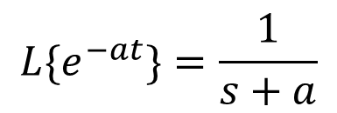
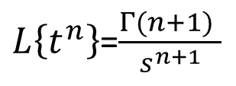
List of Transforms
$$L\left\{f\left(t\right)\right\}=\int_{0}^{∞}{e^{−st}}f\left(t\right)dt$$
$$L\left\{e^{at}\right\}= \frac{1}{(s−a)}$$
$$L\{cosh at\}=\frac{s}{s^{2}−a^{2}}$$
$$L\{sinh at\}=\frac{a}{s^{2}−a^{2}}$$
$${L\{e}^{−at}\}=\frac{1}{s+a}$$
$L\left\{t^{n}\right\}$=$\frac{Γ(n+1) }{s^{n+1}}$
$$L\{k\}=\frac{k}{s}$$

Slide 4

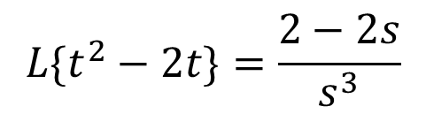
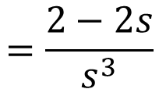
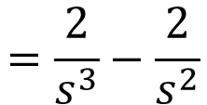

Example Problems
1. Find the Laplace Transform of $f\left(t\right)=t^{2}−2t$
Solution:
$$L\{f\left(t\right)\}=L\{t^{2}−2t\}$$
$$=L\{t^{2}\}−2L\{t\}$$
$$=\frac{2}{s^{3}}−\frac{2}{s^{2}}$$
$$=\frac{2−2s}{s^{3}}$$
$$L\{t^{2}−2t\}=\frac{2−2s}{s^{3}}$$

Slide 5
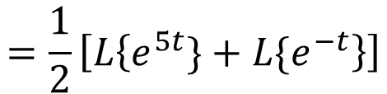

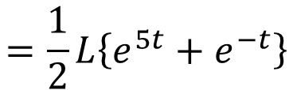
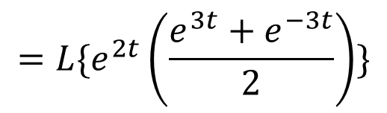
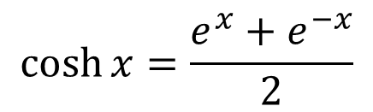
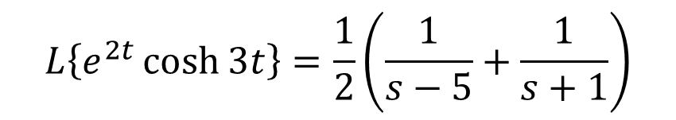
Problems Cont…
2. Find the Laplace Transform of $f\left(t\right)=e^{2t}\cosh{3t}$
Solution:
$$L\{f\left(t\right)\}=L\{e^{2t}\cosh{3t}\}$$
$$=L\{e^{2t}\left(\frac{e^{3t}+e^{−3t}}{2}\right)\}$$
$$cosh⁡x=\frac{e^{x}+e^{−x}}{2}$$
$$=\frac{1}{2}L\left\{e^{5t}+e^{−t}\right\}$$
$$=\frac{1}{2}\left[L\left\{e^{5t}\}+L\{e^{−t}\right\}\right]$$
$$L\left\{e^{2t}\cosh{3t}\right\}=\frac{1}{2}\left(\frac{1}{s−5}+\frac{1}{s+1}\right)$$

Slide 6
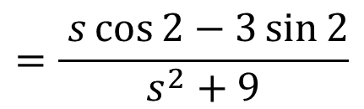

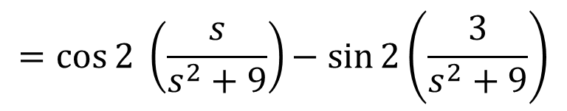



Problems Cont…
3. Find the Laplace Transform of $f\left(t\right)=\cos{(3t+2)}$
Solution:
$$L\{f\left(t\right)\}=L\{\cos{(3t+2)}\}$$
$$\cos\left(A+B\right)=\cos{A}\cos{B}−\sin{A}\sin{B}$$
$$=L\{\cos{3t\cos{2 }−\sin{3t}\sin{2}}\}$$
$$=\cos{2 }L\{\cos{3t\}−\sin{2}L\{sin{3t\}}}$$
$$=\cos{2 }\left(\frac{s}{s^{2}+9}\right)− sin{2\left(\frac{3}{s^{2}+9}\right)}$$
$$=\frac{ s\cos{2−3\sin{2}}}{s^{2}+9}$$
$$L\{\cos{(3t+2)}\}$$

Slide 7
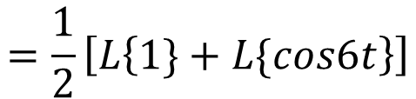

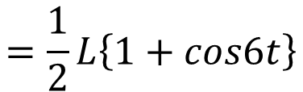
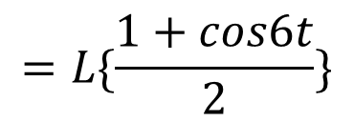

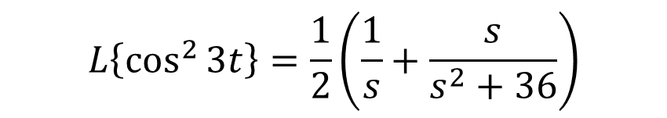
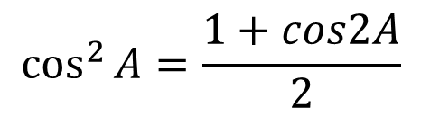
Problems Cont…
4. Find the Laplace Transform of $f\left(t\right)=\cos^{2}{3t}$
Solution:
$$L\{f\left(t\right)\}=L\{\cos^{2}{3t}\}$$
$$=L\{\frac{1+cos6t}{2}\}$$
$$\cos{2A=2\cos^{2}{A}−1}$$
$$\cos^{2}{A}=\frac{1+cos2A}{2}$$
$$=\frac{1}{2}L\left\{1+cos6t\right\}$$
$$=\frac{1}{2}\left[L\left\{1\}+L\{cos6t\right\}\right]$$
$$L\left\{\cos^{2}{3t}\right\}=\frac{1}{2}\left(\frac{1}{s}+\frac{s}{s^{2}+36}\right)$$

Slide 8
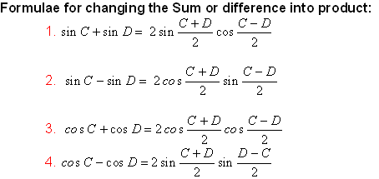

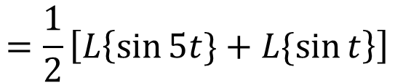
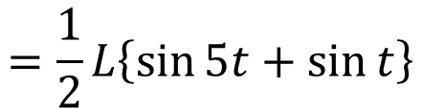
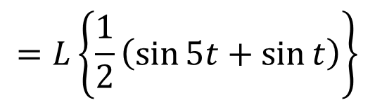
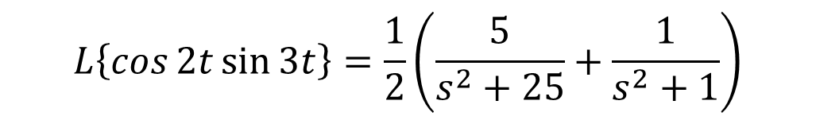
Problems Cont…
5. Find the Laplace Transform of $f\left(t\right)=\cos{2t\sin{3t}}$
Solution:
$$L\{f\left(t\right)\}=L\{\cos{2t\sin{3t}}\}$$
$$=L\left\{\frac{1}{2}\left(\sin{5t}+\sin{t}\right)\right\}$$
$$=\frac{1}{2}L\left\{\sin{5t}+\sin{t}\right\}$$
$$=\frac{1}{2}\left[L\left\{\sin{5t}\}+L\{\sin{t}\right\}\right]$$
$$L\left\{\cos{2t\sin{3t}}\right\}=\frac{1}{2}\left(\frac{5}{s^{2}+25}+\frac{1}{s^{2}+1}\right)$$

Slide 9
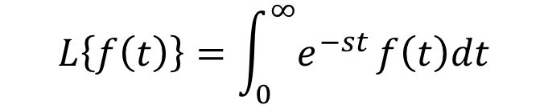
Problems Cont…
Find the Laplace Transform of
Solution:
$$L\left\{f\left(t\right)\right\}=\int_{0}^{∞}{e^{−st}}f\left(t\right)dt$$

Slide 10










Home work problems
Find the Laplace Transform for the following functions
$$1. f\left(t\right)=t^{2}−3t+2$$
2$. f\left(t\right)={\left(t^{2}−3\right)}^{2}$
$$8. f\left(t\right)=\sin{3t }\sin{2t}$$
$$3. f\left(t\right)=\sin^{2}{4t}$$
$$9. f\left(t\right)=\cos{3t }\cos{5t}$$
$$4. f\left(t\right)=\sin^{3}{2t}$$
$$10. f\left(t\right)=\cos^{2}{3t}−\sin^{2}{3t}$$
$$5. f\left(t\right)=2\cos^{3}{2t}$$
$6. f(t)=$ $e^{\frac{1}{2}t}\sinh{\frac{3}{2}t}$
$$7. f\left(t\right)=\sin{2t}\cos{2t}$$

Slide 11


